Slide 1
1
Introduction to Differential Equations

Slide 2
1.1
Definitions and Terminology

Slide 3
Definitions and Terminology (1 of 20)
Definition 1.1.1 Differential Equation
An equation containing the derivatives of one or more unknown functions (or dependent variables), with respect to one or more independent variables, is said to be a differential equation (DE).

Slide 4
Definitions and Terminology (2 of 20)
Classification by Type
If a differential equation contains only ordinary derivatives of one or more unknown functions with respect to a single independent variable, it is said to be an ordinary differential equation (ODE).
An equation involving partial derivatives of one or more unknown functions of two or more independent variables is called a partial differential equation (PDE). Our first example illustrates several of each type of differential equation.

Slide 5
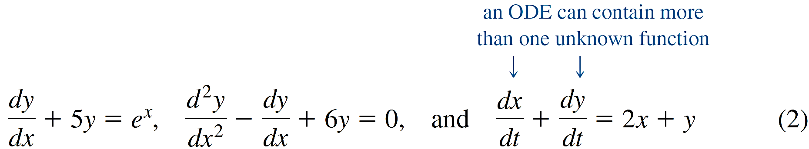
Example 1 – Types of Differential Equations (1 of 2)
(a) The equations
are examples of ordinary differential equations.

Slide 6
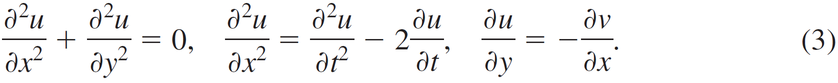
Example 1 – Types of Differential Equations (2 of 2)
(b) The following equations are partial differential equations:

Slide 7

Definitions and Terminology (3 of 20)
Notation
Throughout this text ordinary derivatives will be written by using either the Leibniz notation
or the prime notation y′, y″, y‴, ....

Slide 8
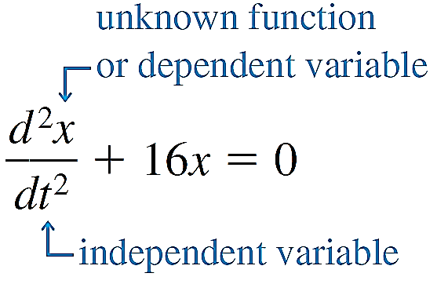
Definitions and Terminology (4 of 20)
For example, in the equation
it is immediately seen that the symbol x now represents a dependent variable, whereas the independent variable is t.

Slide 9


Definitions and Terminology (5 of 20)
You should also be aware that in physical sciences and engineering, Newton’s dot notation (derogatorily referred to by some as the “flyspeck” notation) is sometimes used to denote derivatives with respect to time t.
Thus the differential equation
becomes
Partial derivatives are often denoted by a subscript notation indicating the independent variables.

Slide 10
Definitions and Terminology (6 of 20)
For example, with the subscript notation the second equation in (3) becomes u _{xx} = u _{tt} − 2u _{t}.

Slide 11
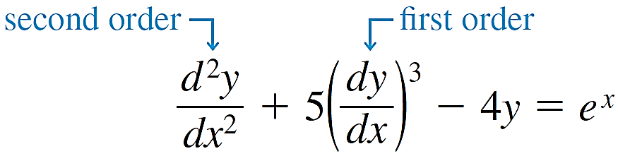
Definitions and Terminology (7 of 20)
Classification by Order
The order of a differential equation (either ODE or PDE) is the order of the highest derivative in the equation. For example,
is a second-order ordinary differential equation. A first-order ordinary differential equation is sometimes written in the differential form
M(x, y) dx + N(x, y) d y = 0.

Slide 12
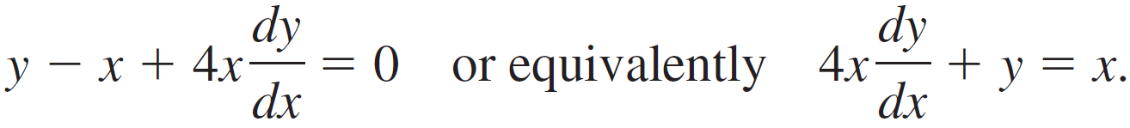
Example 2 – Differential Form of a First-Order ODE (1 of 2)
If we assume that y is the dependent variable in a first-order ODE, then recall from calculus that the differential d y is defined to be d y = y′ dx.
(a) By dividing by the differential dx an alternative form of the equation (y − x) dx + 4x d y = 0 is given by

Slide 13
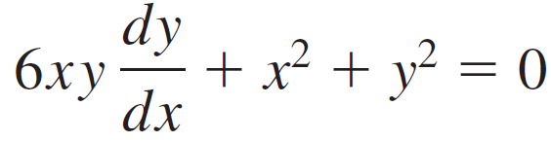

Example 2 – Differential Form of a First-Order ODE (2 of 2)
(b) By multiplying the differential equation
by dx we see that the equation has the alternative differential form

Slide 14


Definitions and Terminology (8 of 20)
In symbols we can express an nth-order ordinary differential equation in one dependent variable by the general form
where F is a real-valued function of n + 2 variables:
x, y, y′, ... ,
For both practical and theoretical reasons we shall also make the assumption hereafter that it is possible to solve an ordinary differential equation in the form (4) uniquely for the highest derivative
in terms of the remaining n + 1 variables.

Slide 15
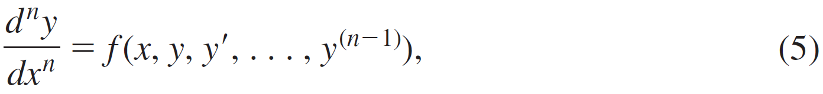
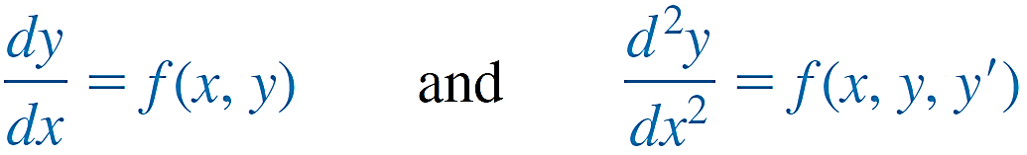
Definitions and Terminology (9 of 20)
The differential equation
where f is a real-valued continuous function, is referred to as the normal form of (4). Thus when it suits our purposes, we shall use the normal forms
to represent general first- and second-order ordinary differential equations.

Slide 16
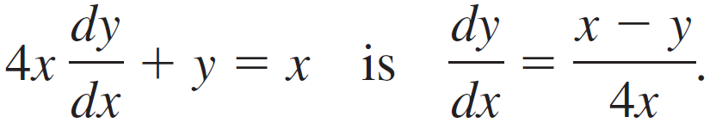
Example 3 – Normal Form of an ODE
(a) By solving for the derivative d y ∕dx the normal form of the first-order differential equation
(b) By solving for the derivative y″ the normal form of the second-order differential equation
y″ − y′ + 6 = 0 is y″ = y′ − 6y.

Slide 17
Definitions and Terminology (10 of 20)
Classification by Linearity
An nth-order ordinary differential equation (4) is said to be linear if F is linear in y, y′, . . . ,
This means that an nth-order ODE is linear when (4) is
or

Slide 18

Definitions and Terminology (11 of 20)
Two important special cases of (6) are linear first-order
(n = 1) and linear second-order (n = 2) DEs:
A nonlinear ordinary differential equation is simply one that is not linear. Nonlinear functions of the dependent variable or its derivatives, such as sin y or
cannot appear in a linear equation.

Slide 19
Example 4 – Linear and Nonlinear ODEs (1 of 2)
(a) The equations
are, in turn, linear first-, second-, and third-order ordinary differential equations.

Slide 20
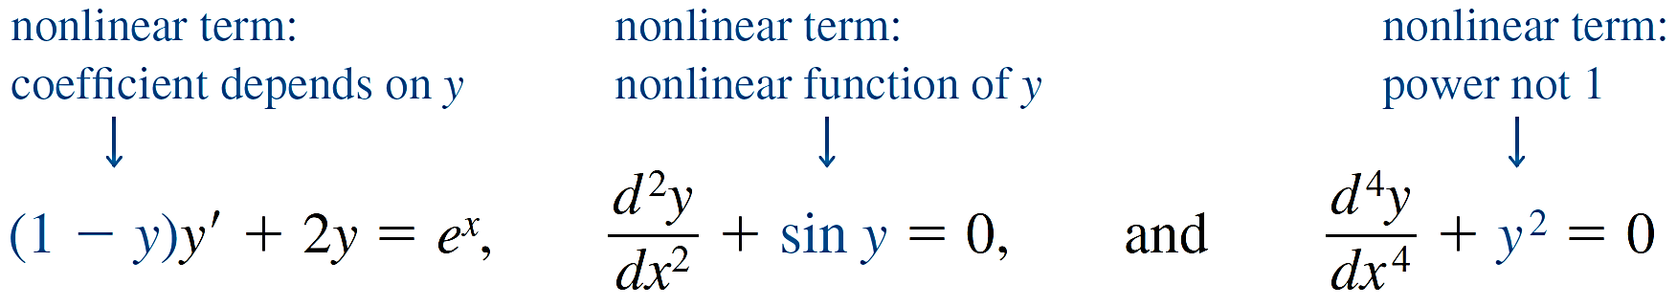
Example 4 – Linear and Nonlinear ODEs (2 of 2)
(b) The equations
are examples of nonlinear first-, second-, and fourth-order ordinary differential equations, respectively.

Slide 21
Definitions and Terminology (12 of 20)
Definition 1.1.2 Solution of an ODE
Any function Φ, defined on an interval I and possessing at least n derivatives that are continuous on I, which when substituted into an nth-order ordinary differential equation reduces the equation to an identity, is said to be a solution of the equation on the interval.

Slide 22
Definitions and Terminology (13 of 20)
Interval of Definition
You cannot think solution of an ordinary differential equation without simultaneously thinking interval. The interval I in previous definition is variously called the interval of definition, the interval of existence, the interval of validity, or the domain of the solution and can be an open interval (a, b), a closed interval [a, b], an infinite interval (a,
), and so on.

Slide 23

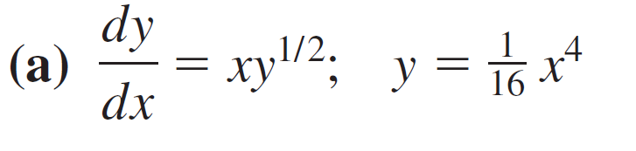
Example 5 – Verification of a Solution
Verify that the indicated function is a solution of the given differential equation on the interval
Solution:
One way of verifying that the given function is a solution is to see, after substituting, whether each side of the equation is the same for every x in the interval.

Slide 24
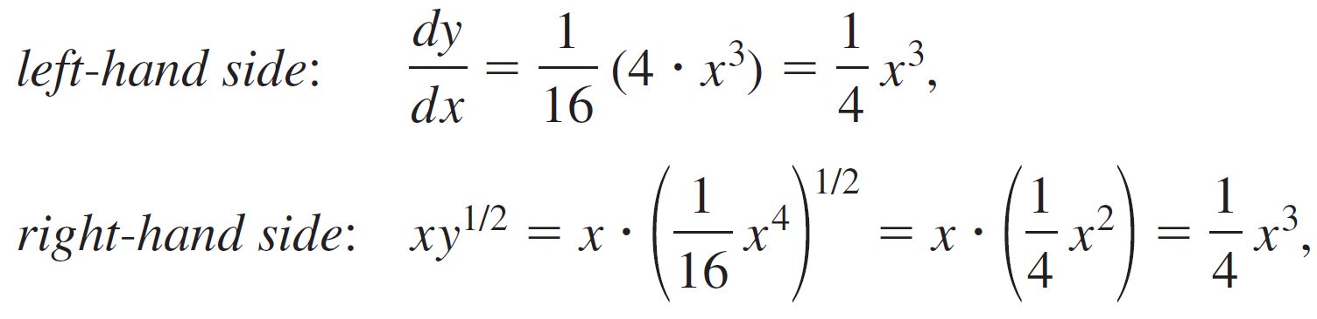


Example 5 – Solution (1 of 1)
From
we see that each side of the equation is the same for every real number x. Note that
is, by definition, the nonnegative square root of

Slide 25
Definitions and Terminology (14 of 20)
A solution of a differential equation that is identically zero on an interval I is said to be a trivial solution.
Solution Curve
The graph of a solution Φ of an ODE is called a solution curve. Since Φ is a differentiable function, it is continuous on its interval I of definition. Thus there may be a difference between the graph of the function Φ and the graph of the solution Φ. Put another way, the domain of the function Φ need not be the same as the interval I of definition (or domain) of the solution Φ. Example 6 illustrates the difference.

Slide 26
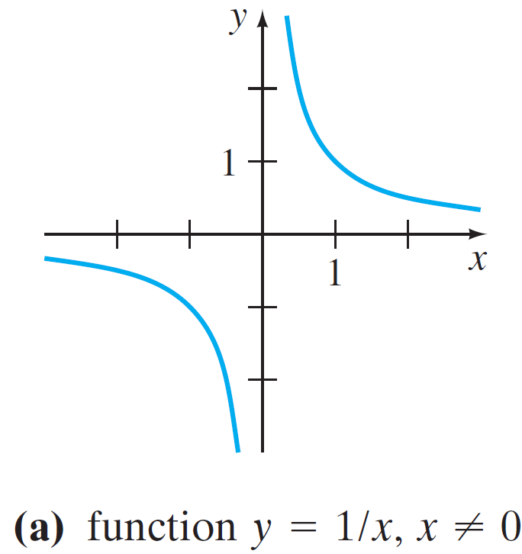
Example 6 – Function versus Solution (1 of 4)
(a) The domain of y = 1 ∕ x, considered simply as a function, is the set of all real numbers x except 0. When we graph y = 1 ∕ x, we plot points in the x y-plane corresponding to a judicious sampling of numbers taken from its domain.
The rational function y = 1 ∕ x is discontinuous at 0, and its graph, in a neighbourhood of the origin, is given in the figure.
In Example 6 the function y = 1 ∕ x is not the same as the solution y = 1 ∕ x
Figure 1.1.1

Slide 27
Example 6 – Function versus Solution (2 of 4)
The function y = 1 ∕ x is not differentiable at x = 0, since the y-axis (whose equation is x = 0) is a vertical asymptote of the graph.
(b) Now y = 1 ∕ x is also a solution of the linear first-order differential equation x y′ + y = 0. (Verify.) But when we say that y = 1 ∕ x is a solution of this DE, we mean that it is a function defined on an interval I on which it is differentiable and satisfies the equation.

Slide 28


Example 6 – Function versus Solution (3 of 4)
In other words, y = 1 ∕ x is a solution of the DE on any interval that does not contain 0, such as (−3, −1),
Because the solution curves defined by y = 1 ∕ x for −3 < x < −1 and
are simply segments, or pieces, of the solution curves defined by y = 1 ∕ x for −
< x < 0 and 0 < x <
, respectively, it makes sense to take the interval I to be as large as possible.

Slide 29


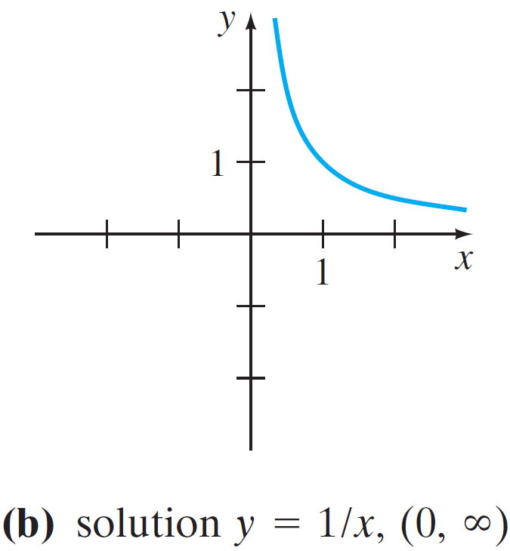
Example 6 – Function versus Solution (4 of 4)
The solution curve on
Thus we take I to be either
is shown in the figure.
In Example 6 the function y = 1 ∕ x is not the same as the solution y = 1 ∕ x
Figure 1.1.1

Slide 30
Definitions and Terminology (15 of 20)
Explicit and Implicit Solutions
A solution in which the dependent variable is expressed solely in terms of the independent variable and constants is said to be an explicit solution.
A relation G(x, y) = 0 is said to be an implicit solution of an ordinary differential equation (4) on an interval I, provided that there exists at least one function Φ that satisfies the relation as well as the differential equation on I.
Definition 1.1.3 Implicit Solution of an ODE

Slide 31

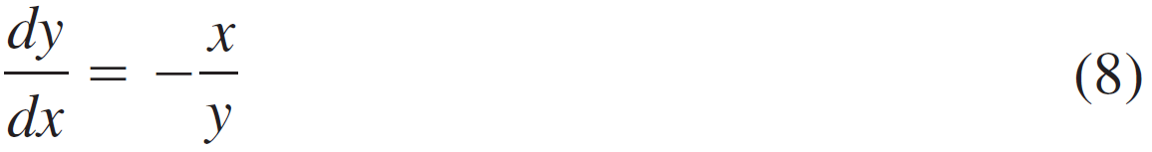
Example 7 – Verification of an Implicit Solution (1 of 3)
is an implicit solution of the differential equation
The relation
on the open interval (−5, 5). By implicit differentiation we obtain

Slide 32

Example 7 – Verification of an Implicit Solution (2 of 3)
Solving the last equation in (9) for the symbol d y ∕ dx gives (8). Moreover, solving
for y in terms of x yields
The two functions
satisfy the relation (that is,
and are explicit solutions defined on the interval (−5, 5).

Slide 33
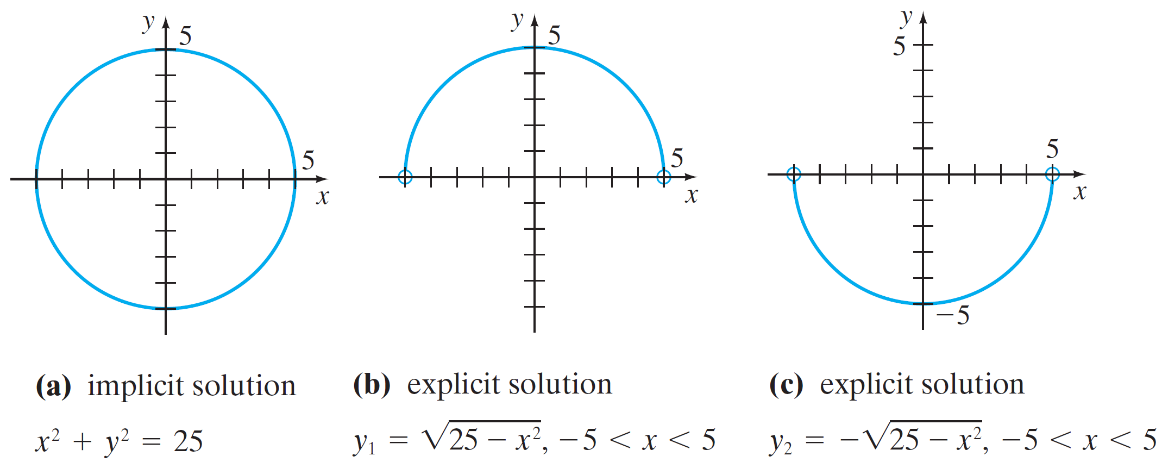
Example 7 – Verification of an Implicit Solution (3 of 3)
The solution curves given in figures are segments of the graph of the implicit solution in the figure.
An implicit solution and two explicit solutions of (8) in Example 7
Figure 1.1.2

Slide 34
Definitions and Terminology (16 of 20)
Families of Solutions
The study of differential equations is similar to that of integral calculus. When evaluating an antiderivative or indefinite integral in calculus, we use a single constant c of integration.
Analogously, we shall see that when solving a first-order differential equation F(x, y, y′) = 0 we usually obtain a solution containing a single constant or parameter c.
A solution of F(x, y, y′) = 0 containing a constant c is a set of solutions G(x, y, c) = 0 called a one-parameter family of solutions.

Slide 35

Definitions and Terminology (17 of 20)
When solving an nth-order differential equation
we seek an n-parameter family of solutions
G(x, y, c₁, c₂, ... , c_{n}) = 0. This means that a single differential equation can possess an infinite number of solutions corresponding to an unlimited number of choices for the parameter(s).
A solution of a differential equation that is free of parameters is called a particular solution.

Slide 36

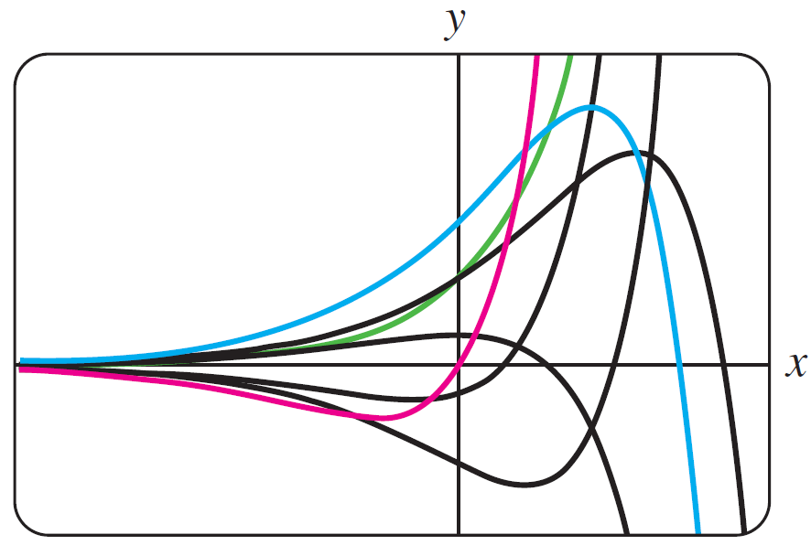



Example 8 – Particular Solutions
The two-parameter family
is an explicit solution of the linear second-order equation
y″ − 2y′ + y = 0
In the figure we have shown seven of the “double infinity” of solutions in the family.
Some solutions of DE in part (b) of Example 8
Figure 1.1.4
The solution curves in red, green, and blue are the graphs of the particular solutions
(c₁ = 0, c₂ = 5),
(c₁ = 3, c₂ = 0), and
(c₁ = 5, c₂ = 2), respectively.

Slide 37
Definitions and Terminology (18 of 20)
Sometimes a differential equation possesses a solution that is not a member of a family of solutions of the equation—that is, a solution that cannot be obtained by specializing any of the parameters in the family of solutions. Such an extra solution is called a singular solution.
In all the preceding examples we used x and y to denote the independent and dependent variables, respectively. But you should become accustomed to seeing and working with other symbols to denote these variables. For example, we could denote the independent variable by t and the dependent variable by x.

Slide 38
Example 9 – Using Different Symbols (1 of 2)
The functions x = c₁ cos 4t and x = c₂ sin 4t, where c₁ and c₂ are arbitrary constants or parameters, are both solutions of the linear differential equation
x″ + 16x = 0.
For x = c₁ cos 4t the first two derivatives with respect to t are x′ = −4c₁ sin 4t and x″ = −16c₁ cos 4t. Substituting x″ and x then gives
x″ + 16x = −16c₁ cos 4t + 16(c₁ cos 4t) = 0.

Slide 39
Example 9 – Using Different Symbols (2 of 2)
In like manner, for x = c₂ sin 4t we have x″ = −16c₂ sin 4t, and so
x″ + 16x = −16c₂ sin 4t + 16(c₂ sin 4t) = 0.
Finally, it is straightforward to verify that the linear combination of solutions, or the two-parameter family
x = c₁ cos 4t + c₂ sin 4t, is also a solution of the differential equation.

Slide 40


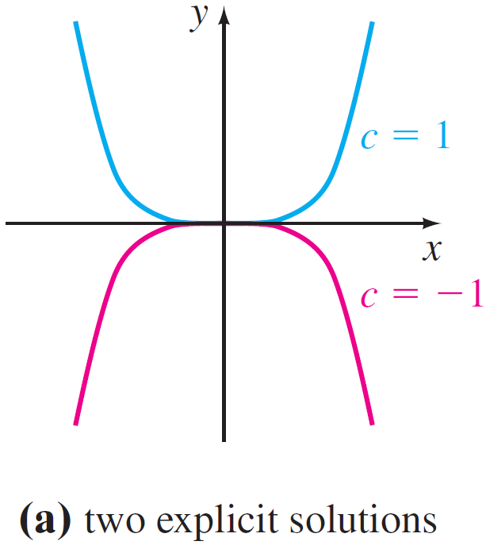

Example 10 – Piecewise-Defined Solution (1 of 2)
The one-parameter family of quartic monomial functions
is an explicit solution of the linear first-order equation xy′ − 4y = 0 on the interval
(Verify.) The blue and red solution curves shown in the figure are the graphs of
and correspond to the choices c = 1 and c = −1, respectively.
Some solutions of DE in Example 10
Figure 1.1.5

Slide 41
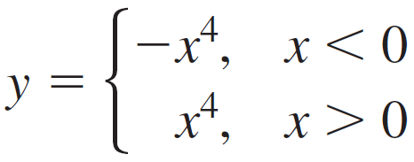

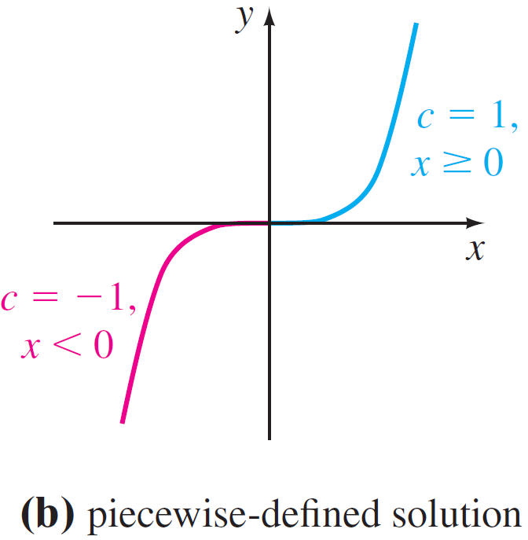
Example 10 – Piecewise-Defined Solution (2 of 2)
The piecewise-defined differentiable function
is also a solution of the differential equation but cannot be obtained from the family
by a single choice of c.
As seen in the figure the solution is constructed from the family by choosing c = −1 for x < 0 and c = 1 for x ≥ 0.
Some solutions of DE in Example 10
Figure 1.1.5

Slide 42
Definitions and Terminology (19 of 20)
Systems of Differential Equations
Up to this point we have been discussing single differential equations containing one unknown function. But often in theory, as well as in many applications, we must deal with systems of differential equations.
A system of ordinary differential equations is two or more equations involving the derivatives of two or more unknown functions of a single independent variable.

Slide 43
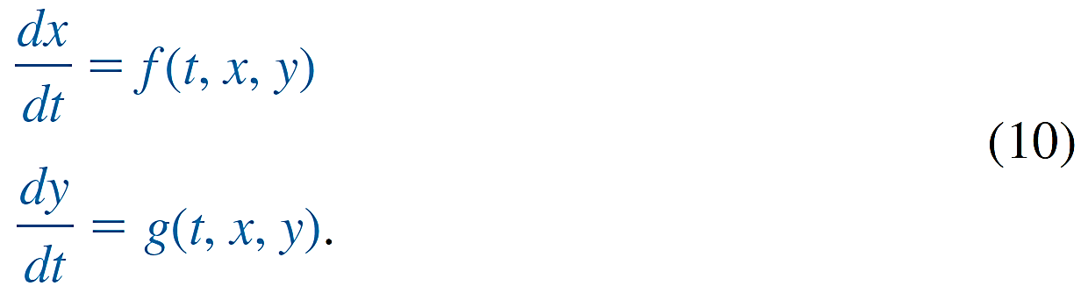
Definitions and Terminology (20 of 20)
For example, if x and y denote dependent variables and t denotes the independent variable, then a system of two first-order differential equations is given by
A solution of a system such as (10) is a pair of differentiable functions x = Φ₁(t), y = Φ₂(t), defined on a common interval I, that satisfy each equation of the system on this interval.

